Slide 1
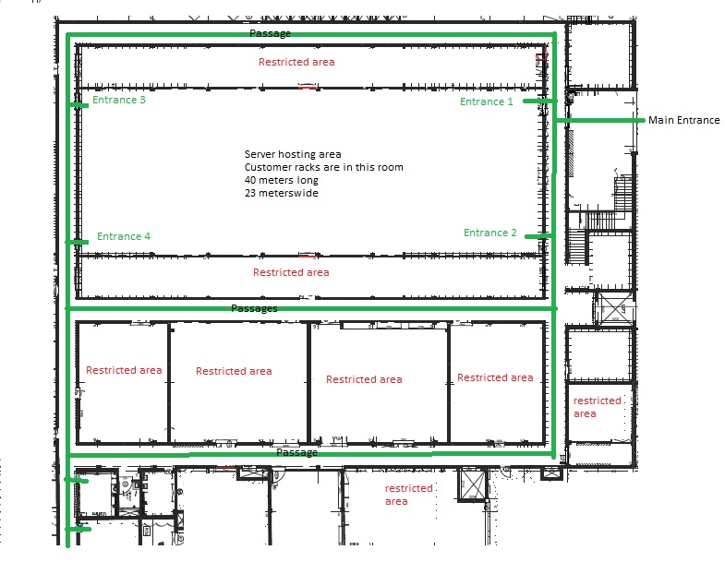
Option 1 - Existing Data Center Area
12 Cameras
8 – inside
2 – at the entrance 1&2
1 – main entrance
1 - Registration
Extended Area
Main Area
Represent a camera with direction

Slide 2
Option 2 - Existing Data Center Area + Extended Area
22 Cameras
16 – inside
4 – at the entrance 1,2,3 & 4
1 – main entrance
1 - Registration
Extended Area
Main Area
Represent a camera with direction

Slide 3
Option 3 - Existing Data Center Area + Passages + Extended Area
32 Cameras
10 - Passages
16 – inside
4 – at the entrance 1,2,3 & 4
1 – main entrance
1 - Registration
Extended Area
Main Area
Represent a camera with direction

